Slide 1

Unit-04 Object Oriented Thinking
Object Oriented Programming (OOP)
(21CS01203)
Prof. Arjun V. Bala
Computer Engineering Department
arjun.bala@darshan.ac.in
9624822202

Slide 2

Outline
Class
Object
Object Oriented Concepts
Encapsulation
Inheritance
Polymorphism
Abstraction
Looping

Slide 3
Class
Class is derived datatype, it combines members of different datatypes into one.
Defines new datatype (primitive ones are not enough).
For Example : Car, College, Bus etc..
This new datatype can be used to create objects.
A class is a template for an object .
Example :
class Car{
String company;
String model;
double price;
double mileage;
………
}

Slide 4
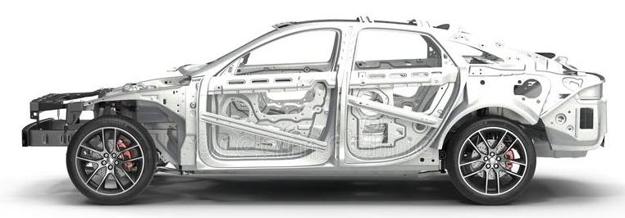
Car Class
Class: Car
Properties (Describe)
Company
Model
Color
Mfg. Year
Price
Fuel Type
Mileage
Gear Type
Power Steering
Anti-Lock braking system
Methods (Functions)
Start
Drive
Park
On_break
On_lock
On_turn

Slide 5
Object
An object is an instance of a class.
An object has a state and behavior.
Example: A dog has
states - color, name, breed as well as
behaviors – wagging the tail, barking, eating.
The state of an object is stored in fields (variables), while methods (functions) display the object's behavior.

Slide 6
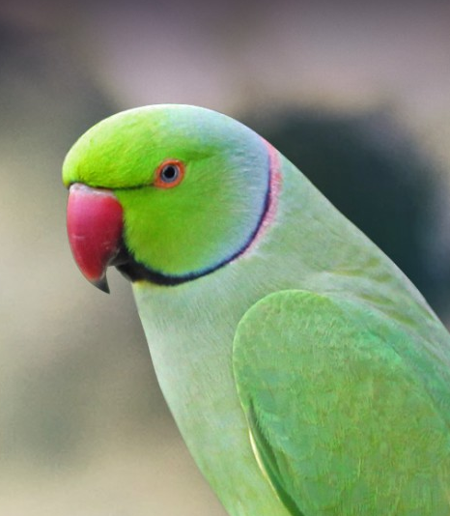
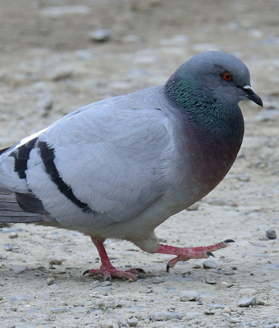
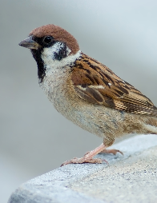
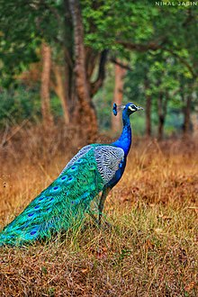

Objects of Class Bird

Slide 7





Objects of a class Car
Honda City
Hyundai i20
Sumo Grand
Mercedes E class
Swift Dzire

Slide 8
Rectangle Class
Properties in rectangle Class
length
width
borderColor
backgroundColor
length = 5
width = 2
borderColor=black
backgroundColor=white
length = 2
width = 5
borderColor=black
backgroundColor=white
length = 3
width = 3
borderColor=red
backgroundColor=white
length = 5
width = 2
borderColor=none
backgroundColor=yellow

Slide 9
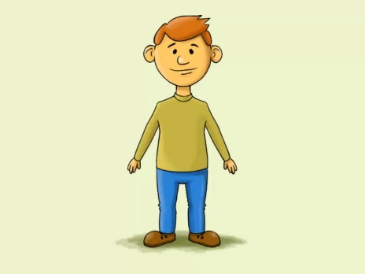
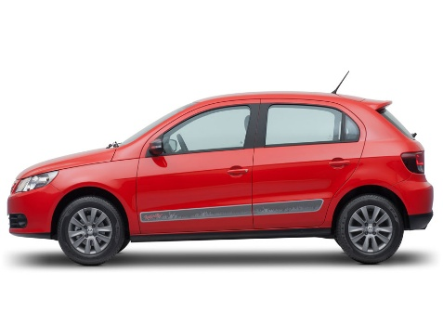
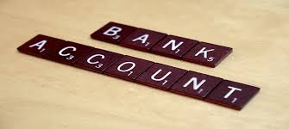
Attributes and operations
Attributes:
Name
Age
Weight
Attributes:
Company
Model
Weight
Attributes:
AccountNo
HolderName
Balance
Operations:
Eat
Sleep
Walk
Operations:
Drive
Stop
FillFuel
Operations:
Deposit
Withdraw
Transfer
Write down 5 objects with its attributes and operations

Slide 10
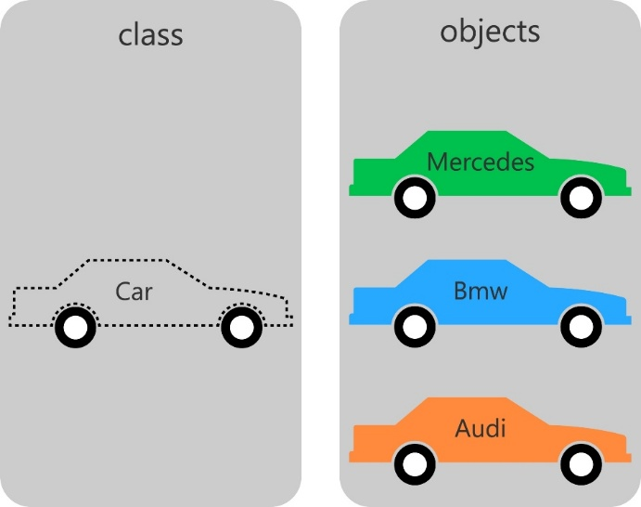
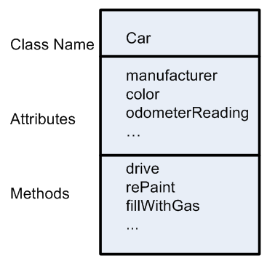
Class

Slide 11
Procedural Vs. Object Oriented Programming
POP | OOP
Emphasis is on doing things not on data, means it is function driven | Emphasis is on data rather than procedure, means object driven
Main focus is on the function and procedures that operate on data | Main focus is on the data that is being operated
Top Down approach in program design | Bottom Up approach in program design
Large programs are divided into smaller programs known as functions | Large programs are divided into classes and objects
Most of the functions share global data | Data is tied together with function in the data structure

Slide 12
Procedural Vs. Object Oriented Programming
POP | OOP
Data moves openly in the system from one function to another function | Data is hidden and cannot be accessed by external functions
Adding of data and function is difficult | Adding of data and function is easy
Concepts like inheritance, polymorphism, data encapsulation, abstraction, access specifiers are not available. | Concepts like inheritance, polymorphism, data encapsulation, abstraction, access specifiers are available and can be used easily
Examples: C, Fortran, Pascal, etc… | Examples: C++, Java, C#, etc…

Slide 13
OOPs Concept
4 pillars that makes language Object Oriented Programming language.
OOP
Encapsulation
Inheritance
Abstraction
Polymorphism

Slide 14
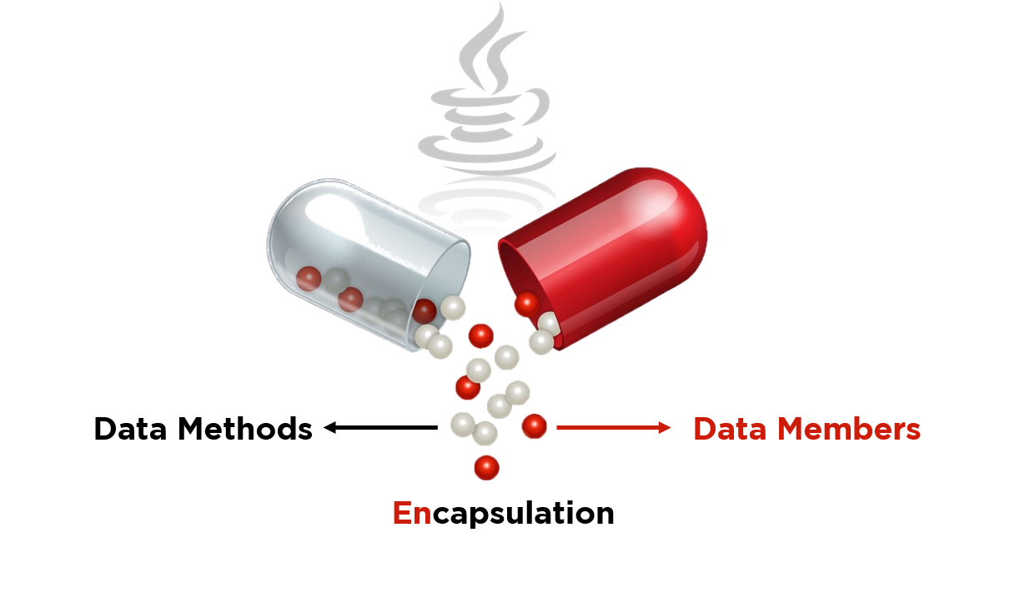
Encapsulation
The wrapping up of data and functions into a single unit is known as encapsulation
The insulation of the data from direct access by the program is called data hiding or information hiding.
It is the process of enclosing one or more details from outside world through access right.
In simple words, "Encapsulation is a process of binging data members (variable, properties) and member functions (methods) into a single unit.

Slide 15
Inheritance
The mechanism of deriving a new class from an old class is called inheritance or derivation.
The old class is known as base class while new class is known as derived class or subclass.
It lets programmers create new classes that share some of the attributes of existing classes.
Inheritance lets us build on previous work without reinventing the wheel.
The inheritance is the most powerful feature of OOP.
Through effective use of inheritance, we can save lot of time in programming and also reduce errors, which in turn will increase the quality of work and productivity.
Employee
Manager
Worker
- ID
- Name
- Address
- Contact
- ID
- Name
- Address
- Contact
- MonthlySalary
- ID
- Name
- Address
- Contact
- DailySalary
- NoOfHours

Slide 16
Another Example of Inheritance
Vehicle
noOfPassanger
maxSpeed
noOfWheels
noOfGears
noOfPassanger
maxSpeed
noOfWheels
noOfGears
noOfPassanger
maxSpeed
noOfWheels
noOfGears
noOfPassanger
maxSpeed
noOfWheels
noOfGears
Inheritance
Inheritance
Inheritance
Bike
cubicCapacity
isMoped
Bike
cubicCapacity
isMoped
Car
horsePower
noOfAirBags
tollTaxAmount()
Car
horsePower
noOfAirBags
tollTaxAmount()
Truck
horsePower
loadingCapacity
payTollTax()
Truck
horsePower
loadingCapacity
payTollTax()

Slide 17
Abstraction
Abstraction refers to the act of representing essential features without including the background details or explanations.
Abstraction provides you a generalized view of your classes or object by providing relevant information.
Abstraction is the process of hiding the working style of an object, and showing the information of an object in understandable manner.
Example:
Electric Switch Board: we need not to worry about the internal work of switch board in order to use it, simply switch on/off to start/stop the device.
Car: you need not to understand how engine works in order to drive a car, you just need to know how to drive the car.
TV Remote: while increasing the TV volume you need not to understand the underlying process, just press the + volume button and it will work.

Slide 18
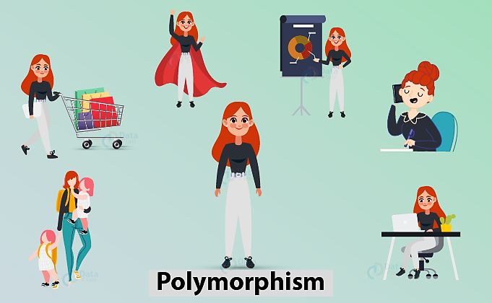
Polymorphism
Polymorphism is a Greek term which means ability to take more than one form.
A person at the same time can have different characteristics. Like a man at the same time is a father, a husband, an employee. So the same person possesses different behavior in different situations. This is called polymorphism.

